Slide 1
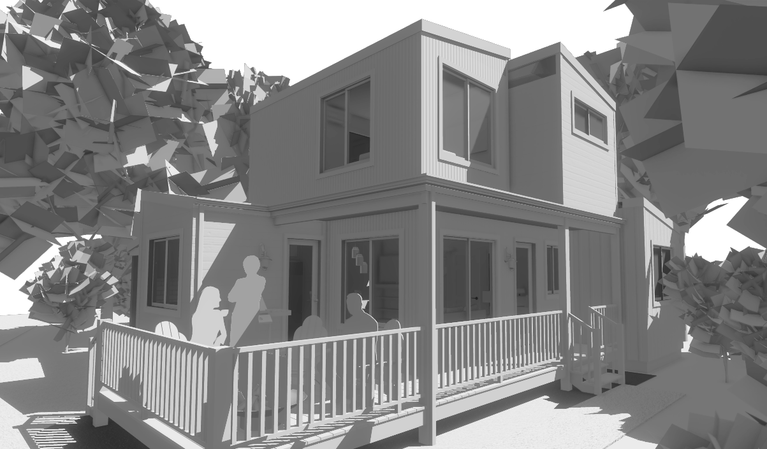
The Micro Modz concept is an innovative residential product with tiny home sized space designs constructed with a process that combines limited offsite production with traditional local permit built housing practices.
Factory built Modular Boxes are framed to IRC standards, have waterproof wall & roof sheathing systems, and windows and doors. Installed. These boxes are economically shipped on standard deck over trailers in compliance with DOT height and width restrictions of 8.5’ wide and 13.5’ high.

Slide 2
MicroModz are an innovative residential construction product and process bringing affordability, aesthetics, sustainability, and quality to multiple housing sectors.
From ADUs to Urban Villages, Pocket Neighborhoods, & Cottage Courts; or on small parcels of land in the mountains or on the farm. MicroModz meet the needs for high density, affordable, single family homes.
Born from a mashup of tiny home, stick-built container home, modular, and net-zero energy concepts they are cute, loveable designs!
Copyright 2023 - Singleton Designs, LLC - Newnan, GA

Slide 3
Non-disruptive Innovation
A hybrid modular concept that fits seamlessly within the locally controlled permitting & inspections process.
Communities retain the bulk of revenue and benefits of labor, materials and components sourced locally.
Unique Product & Process
Micro sized modular ‘boxes’ built off-site;
with Zip-System waterproof sheathing/roof decking, and exterior windows & doors;
transported via standard ‘deck-over’ trailers hauled by ½ ton pickup trucks;
to be anchored in place on site-built crawl space foundations.
Copyright 2023 - Singleton Designs, LLC - Newnan, GA

Slide 4
A New Design Paradigm
Introducing an Architectural style to be identified as “Boxes Style.”
Based on Minimalist Living requirements for efficient space utilization.
Design flexibility beyond the limits of 20’ or 40’ boxes
Energy Efficient & Economical
Construction plans comply with Net-Zero Ready homes with efficient use of materials.
Simple, and easily scalable, off-site construction facility requirements.
Economical, permit free, transportation of box modules to construction sites.
Copyright 2023 - Singleton Designs, LLC - Newnan, GA

Slide 5
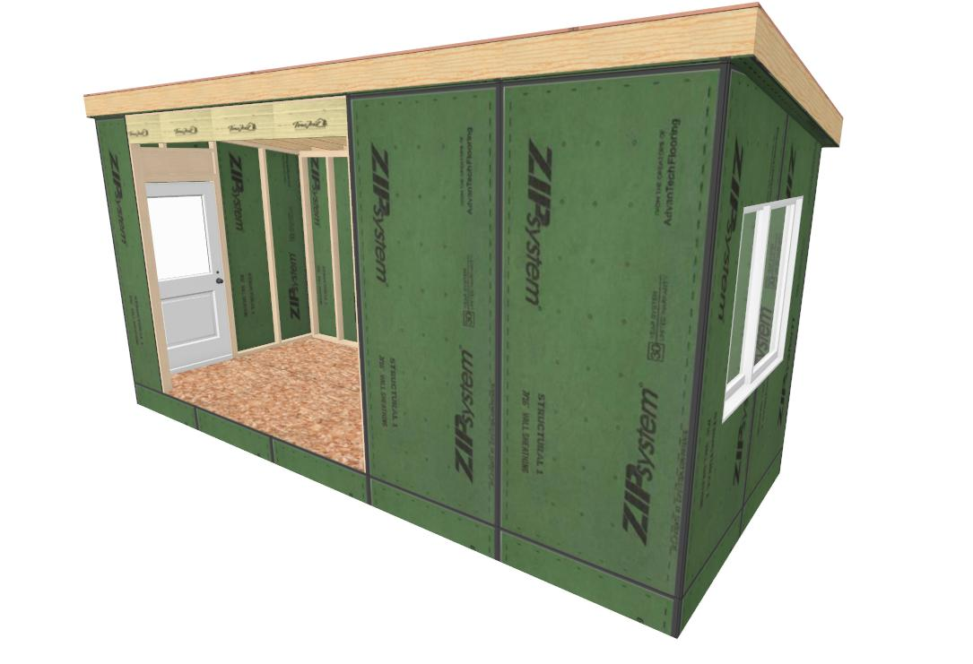
Built Offsite & Assembled Onsite
Ready to ship, pick, and anchor to the foundation. Load the trailers, deliver to the site, and let the small crane and crew get to work.
Copyright 2023 - Singleton Designs, LLC - Newnan, GA

Slide 6
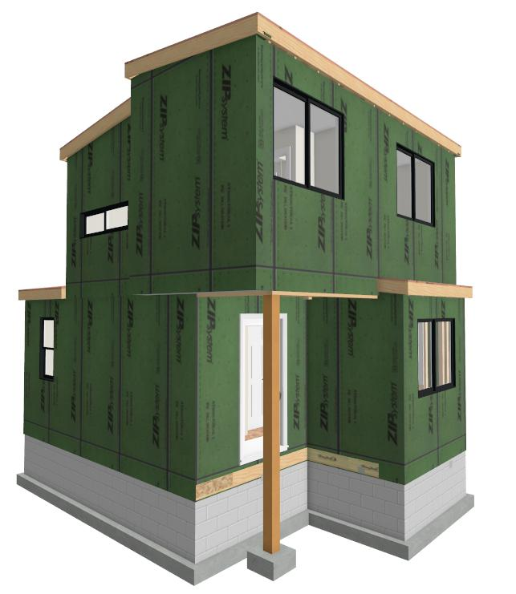
‘Stitch’ the joints, tape the seams, add a door lock, and the local build out & inspection process begins.
Copyright 2023 - Singleton Designs, LLC - Newnan, GA

Slide 7
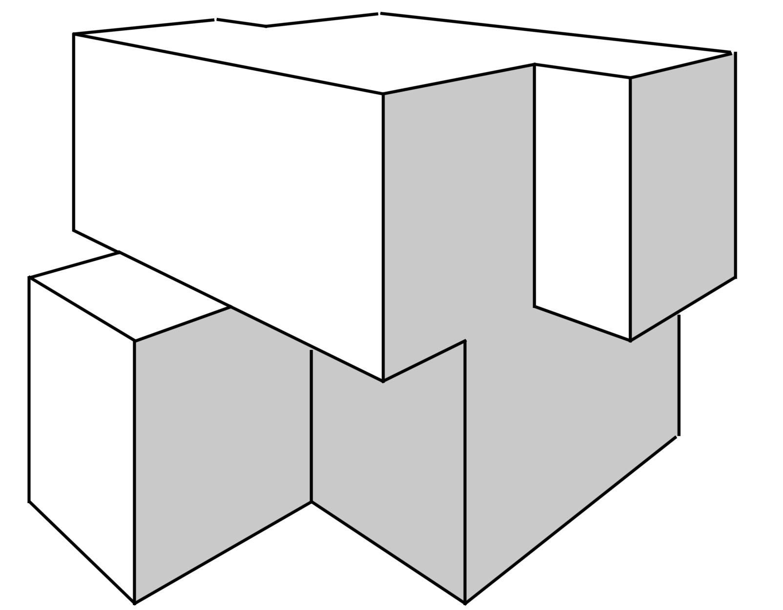
The MicroModz Plan Collection
Each model is identified by square feet, modules over modules, # of bedrooms, # of bonus spaces, # of bathrooms, and optional/addition features..
For example: The MM 860 3-3 312.5 +Storage model is an 860 sq.ft. home with 3 boxes stacked on top of 3. It is laid out with 3 bedrooms, a Loft, 2.5 baths and includes a Storage Area accessible from outside.
One of the modules for this model, like others, with 2 story vaulted Living Areas, does not include a floor and is designed to have ‘cut-away’ bracing and be turned on its side for transport.
The insulated, encapsulated & conditioned crawl space is accessible for storage from under the interior stairs on this and most models.
Copyright 2023 - Singleton Designs, LLC - Newnan, GA

Slide 8
The MicroModz Plan Collection Index
To Design Images
1 | MM 370 1-3 111 + 73 Sq.Ft. Loft | Slides 17 - 20
2 | MM 450 1-2 101.5 | Slides 21 - 23
3 | MM 550 2-2 201.5 | Slides 24 - 27
4 | MM 605 2-3 111.5 | Slides 28 - 31
5 | MM 683 2-2 212 | Slides 32 - 34
6 | MM 750 3-3 212.5 | Slides 35 - 38
7 | MM 801 3-3 302 | Slides 39 - 42
8 | MM 825 3-3 312 * Storage | Slides 43 - 46
9 | MM 850 2-4 323 + Storage | Slides 47 - 49
10 | MM 860 3-3 312.5 + Storage | Slides 50 - 53
11 | MM 884 3-3 412.5 | Slides 54 - 57
12 | MM 896 3-3 312 | Slides 58 - 62
13 | MM 901 4-4 302.5 + Storage | Slides 62 - 66
14 | MM 927 3-3 413.5 | Slides 66 - 69
15 | MM 950 2-3-2 302.5 | Slides 70 - 73
16 | MM 1000 3-3 303.5 | Slides 74 - 76
17 | MM 1012 3-3 413.5 | Slides 77 - 79
18 | MM 1040 3-3 503.5 | Slides 80 - 84
Copyright 2023 - Singleton Designs, LLC - Newnan, GA

Slide 9
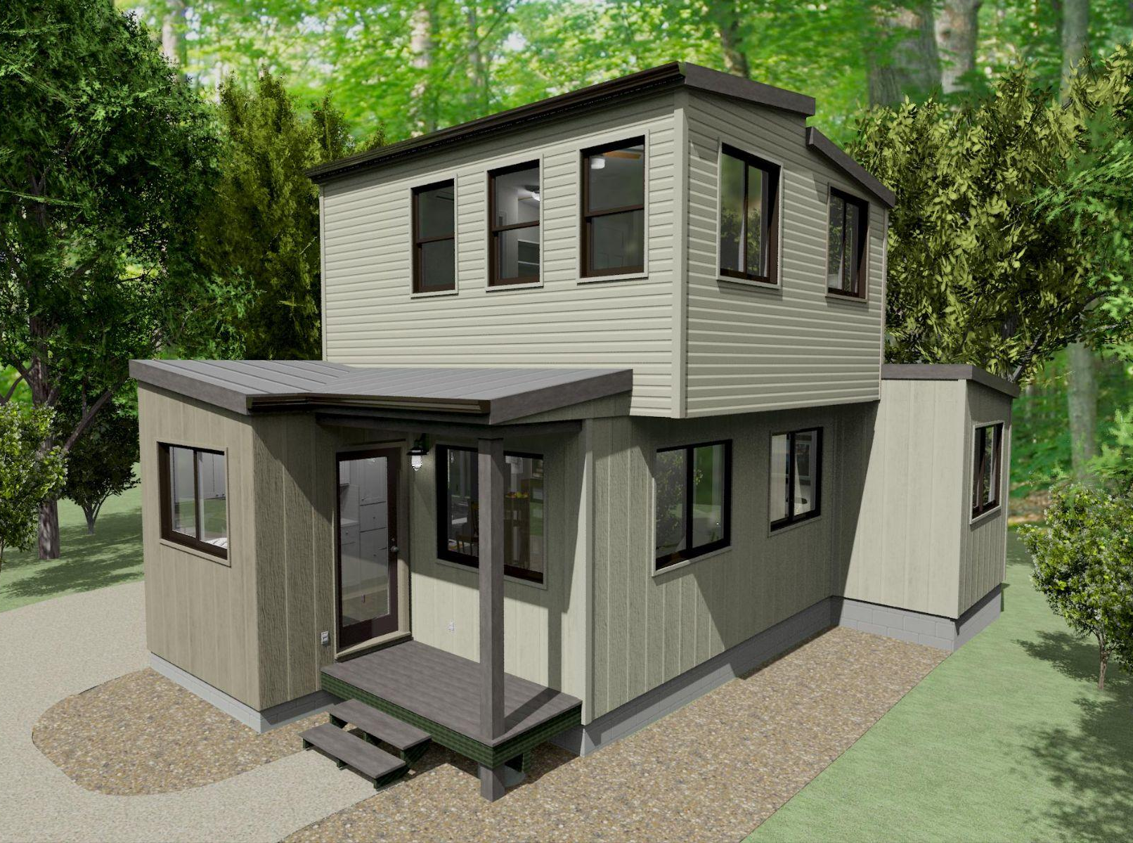
MM 736 2-3 222 +Storage
2 Bedrooms, a Loft, an Office, 2 Bathrooms and Outdoor Storage
The 1st Floor alone of this 736 sq. ft. home is ideal for a single person who works from home. 2nd floor area offers plenty of private space for a roommate.
Copyright 2023 - Singleton Designs, LLC - Newnan, GA

Slide 10
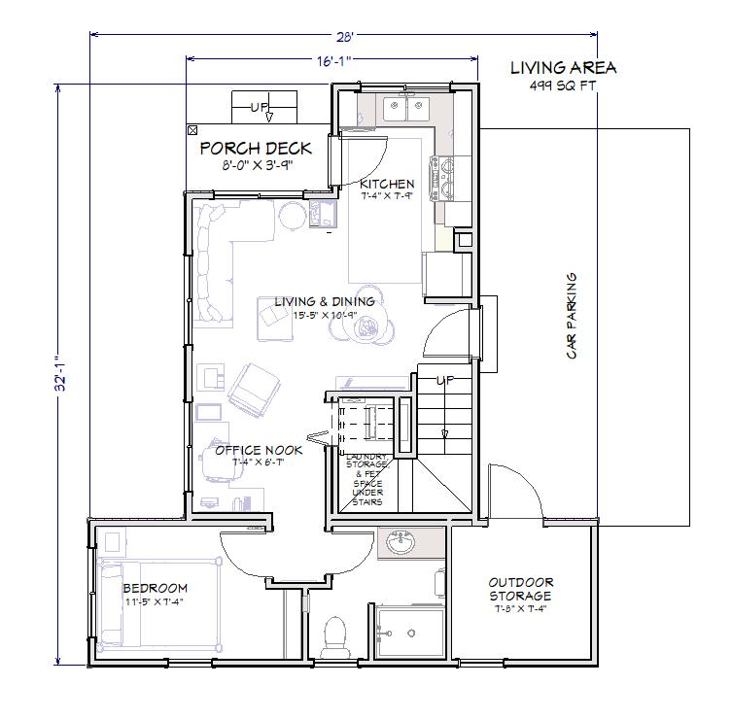
MicroModz 736 2-3 201.5 +Storage
736 Sq. Ft. 2 BR, 2BA with 30’ x 34’ 1” Footprint
1st Floor
.
Copyright 2023 - Singleton Designs, LLC - Newnan, GA

Slide 11
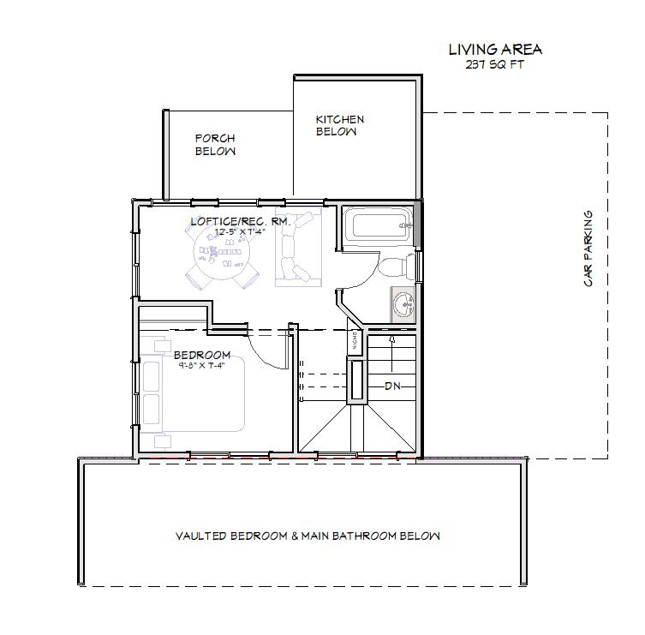
MicroModz 736 2-3 201.5 +Storage
5 Modules: 30’, 24’, and 18’ on Main - 2 @ 18’ on Upper
2nd Floor
.
Copyright 2023 - Singleton Designs, LLC - Newnan, GA

Slide 12
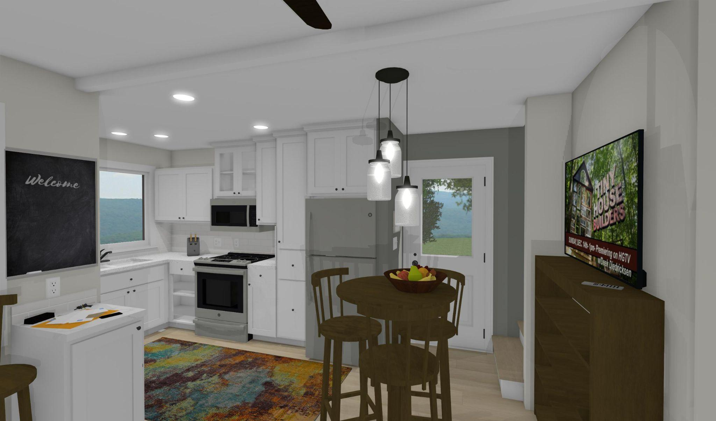
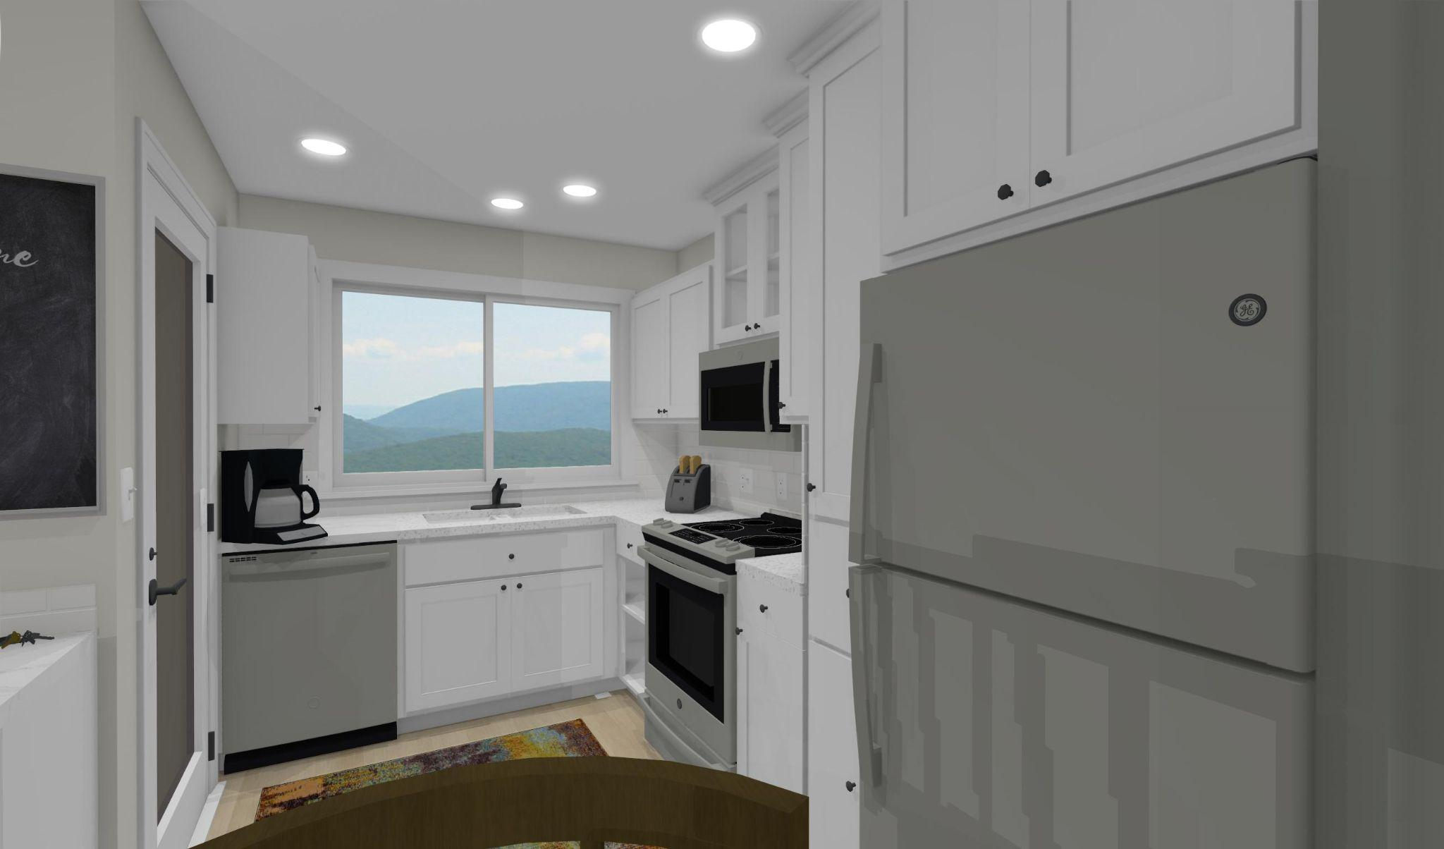
MicroMod 736 2-3 222 +Storage Dining & Kitchen
Copyright 2023 - Singleton Designs, LLC - Newnan, GA

Slide 13
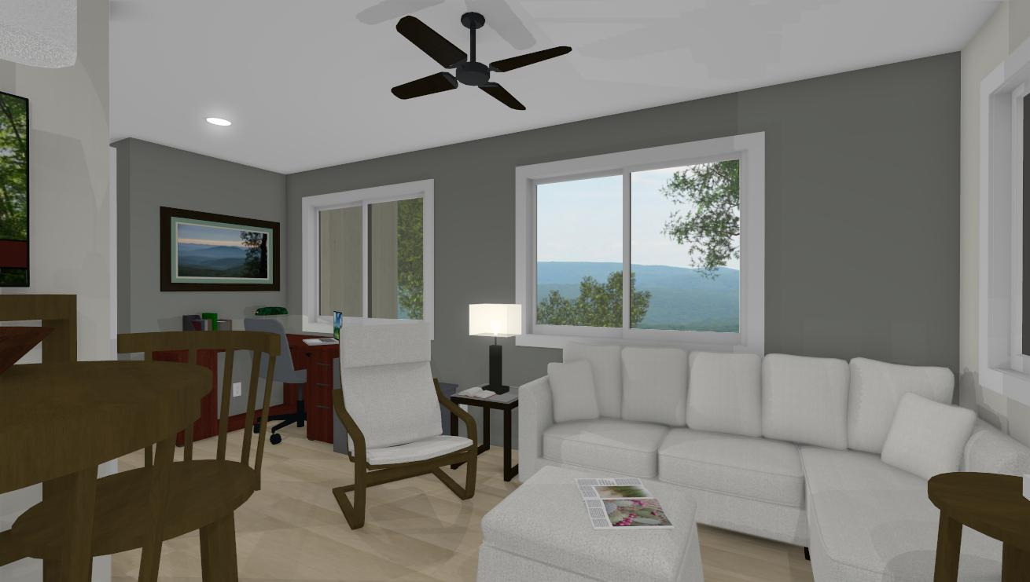
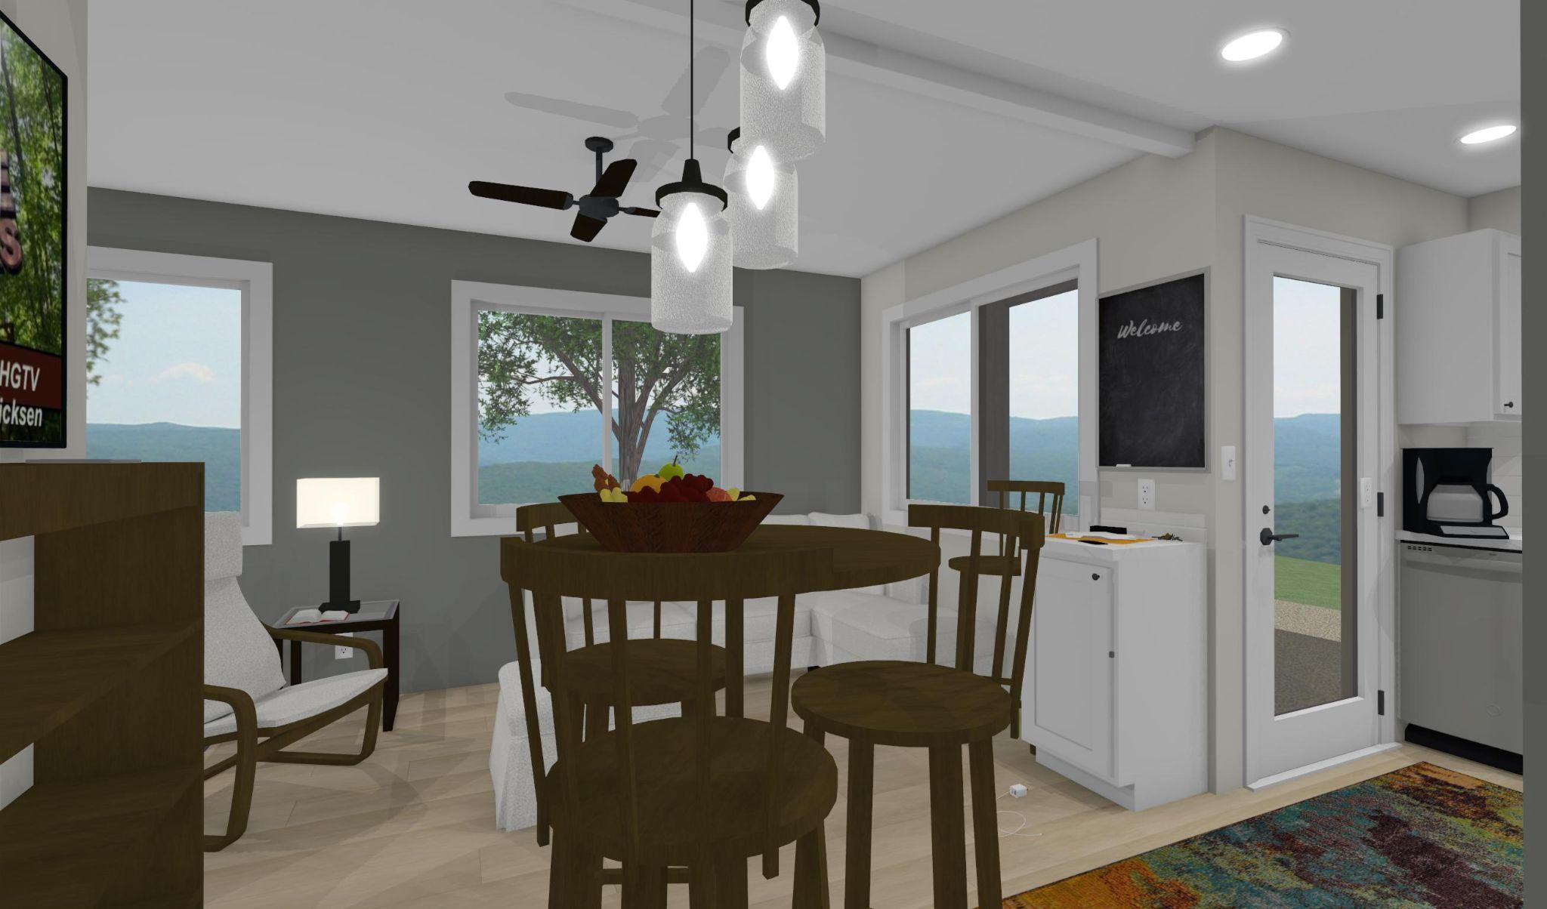
MicroMod 736 2-3 222 Dining , Living & Office Nook
Copyright 2023 - Singleton Designs, LLC - Newnan, GA

Slide 14
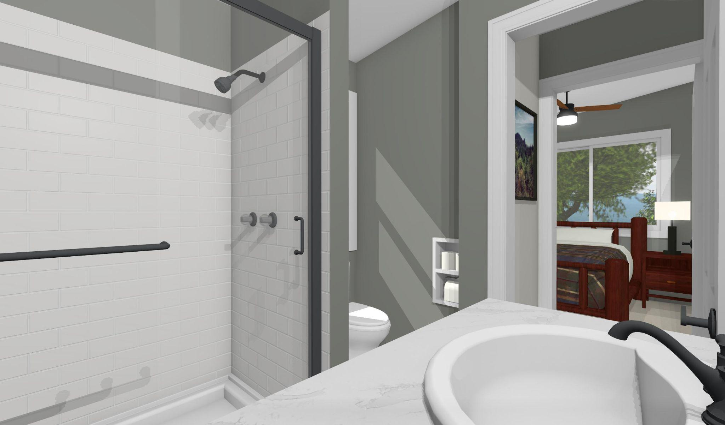
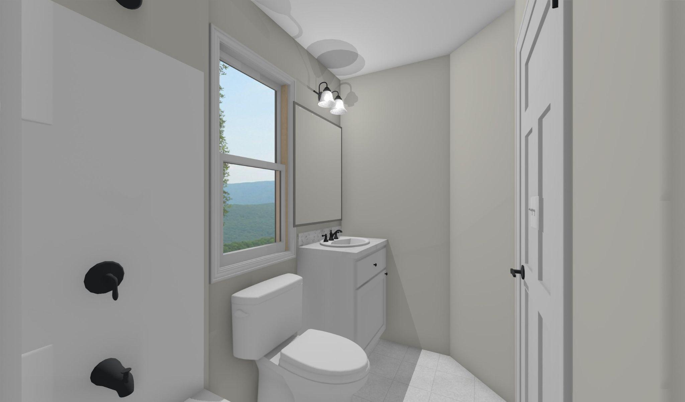
MicroMod 736 2-3 222 Bathrooms
Copyright 2023 - Singleton Designs, LLC - Newnan, GA

Slide 15
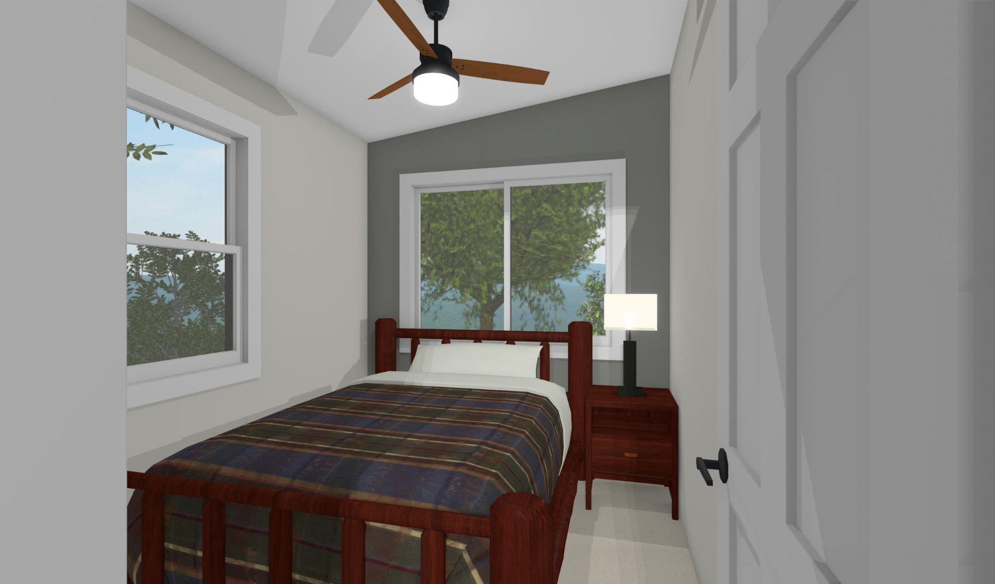
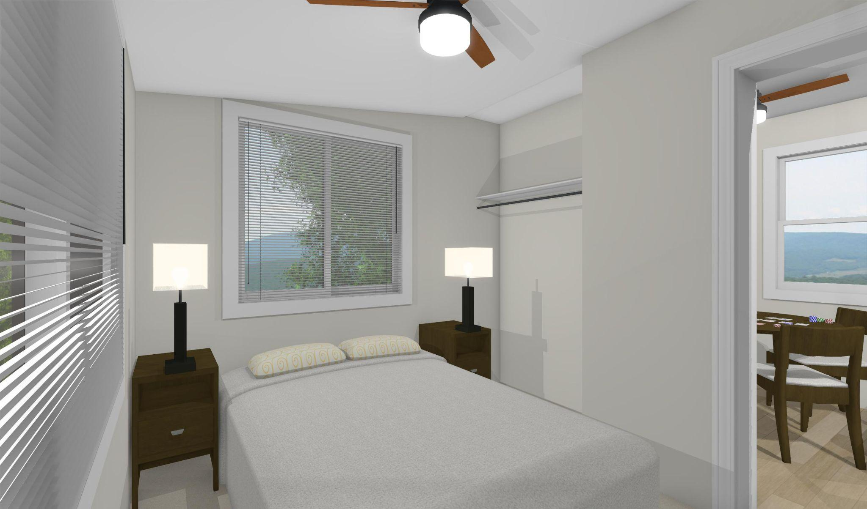
MicroMod 736 2-3 222 Bedrooms
NOTE: These images are from a reversed plan of this model
Copyright 2023 - Singleton Designs, LLC - Newnan, GA

Slide 16
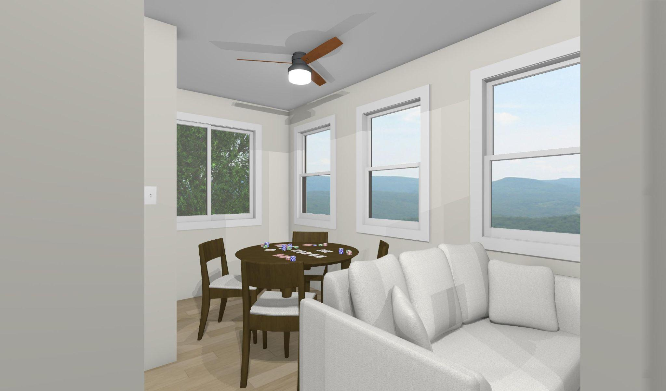
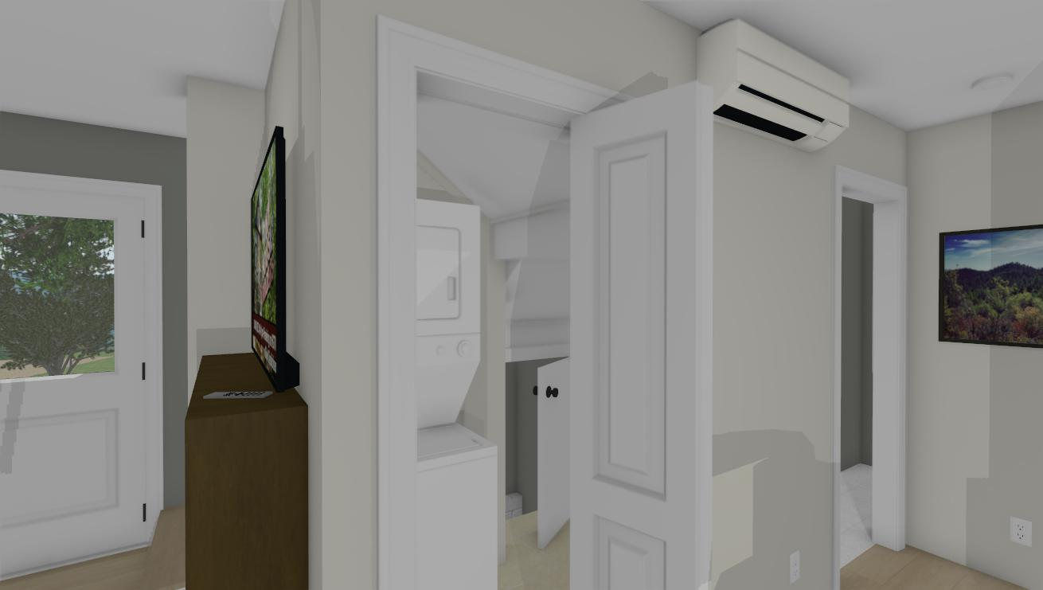
MicroMod 5-736-222 Loftice/Rec. Room
Laundry and access to Crawl Space under stairs
Copyright 2023 - Singleton Designs, LLC - Newnan, GA

Slide 17
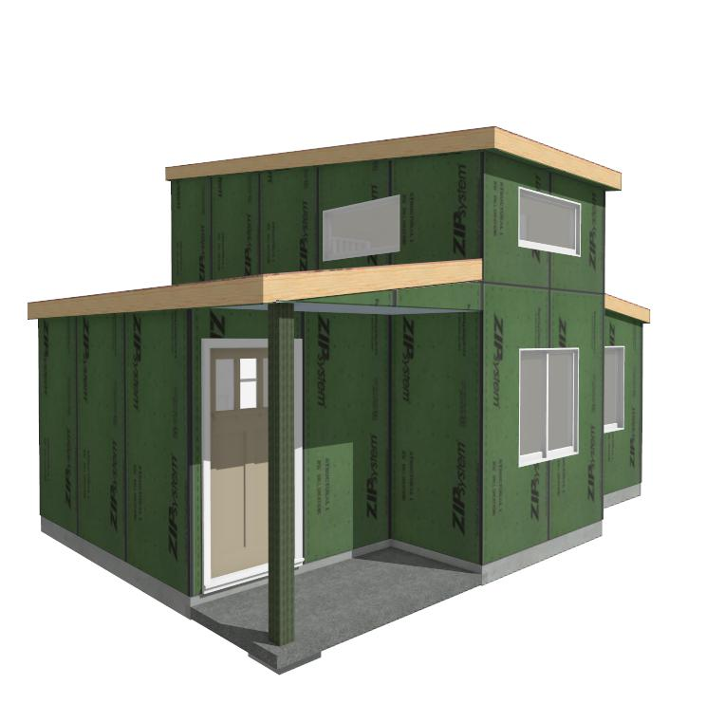
MicroModz 370 1-3 111
370 Sq. Ft. 1 BR, 1BA, Tiny HOME with 73 Sq.Ft. Loft Area
Front View
Copyright 2023 - Singleton Designs, LLC - Newnan, GA

Slide 18
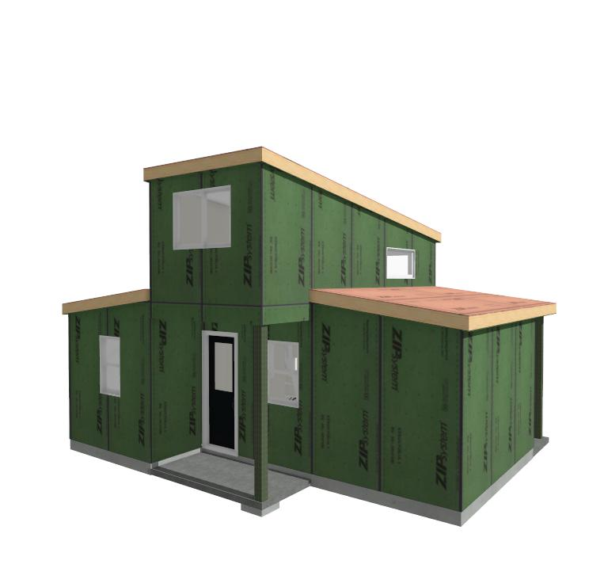
MicroModz 370 1-3 111
1 20’ Box over 3 boxes at: 12’, 16’, & 18’’
Rear View
Copyright 2023 - Singleton Designs, LLC - Newnan, GA

Slide 19
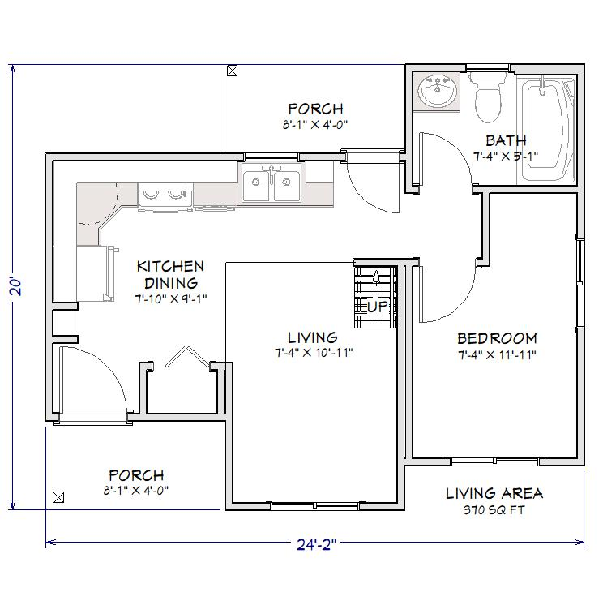
MicroModz 370 1-3 111
Front and Back Porches and the vaulted Living Area with lots of light from above make this Tiny Home feel ‘supersized.’
1st Floor
.
Copyright 2023 - Singleton Designs, LLC - Newnan, GA

Slide 20
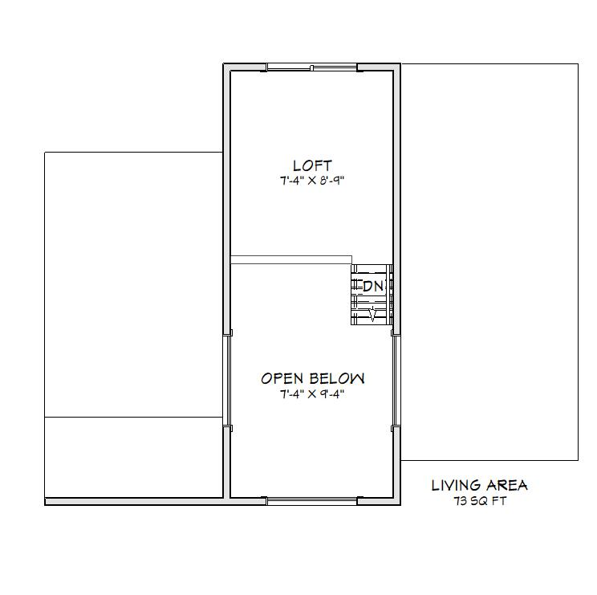
MicroModz 370 1-3 111
Loft Space meets IRC Appendix Q requirements for habitable Living space in addition to the Main Level
2nd Floor
.
Return to Index Page
Copyright 2023 - Singleton Designs, LLC - Newnan, GA

Slide 21
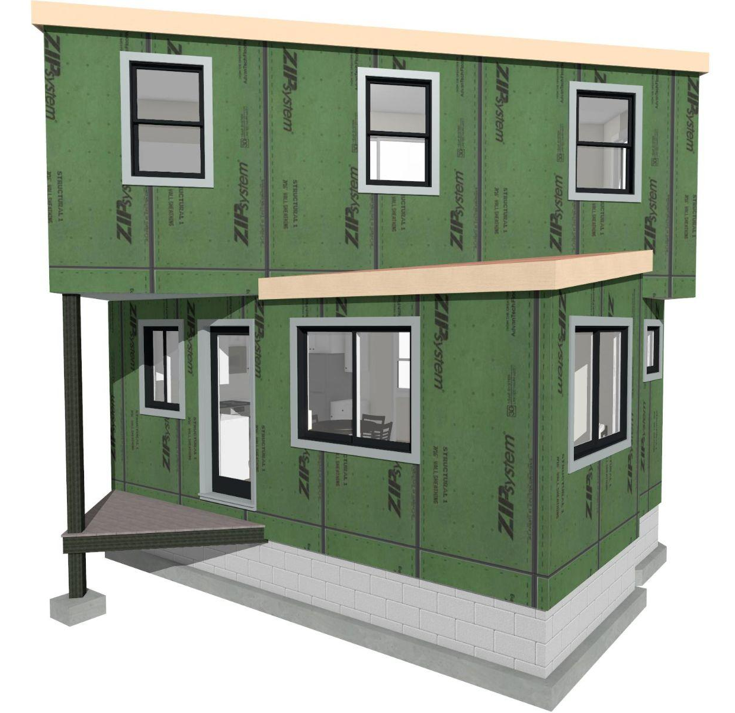
MicroModz 450 1-2 101.5
450 Sq. Ft. 1 BR, 1.5BA; Great Rm Layout
FOLLOW THIS LINK TO VIEW 3D MODEL ON THE CHIEF ARCHITECT SERVER
https://accounts.chiefarchitect.com/3DV/view?share=622253544245343
Copyright 2023 - Singleton Designs, LLC - Newnan, GA

Slide 22
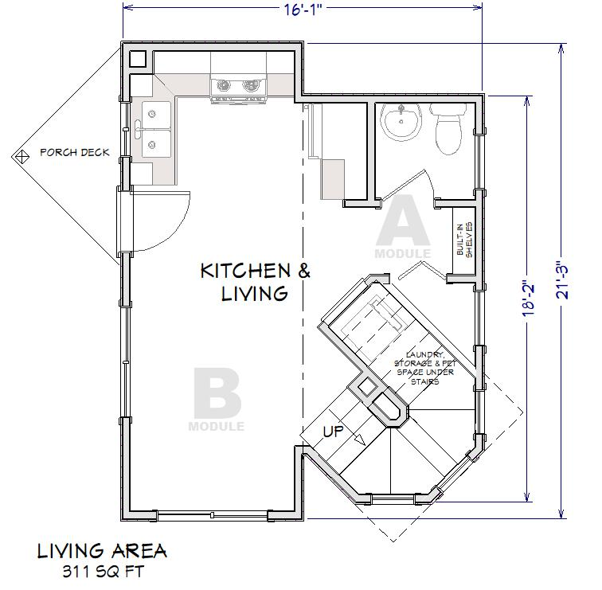
MicroModz 450 1-2 101.5
450 Sq. Ft. 1 BR, 1.5BA with 16’ 1” x 21’ 3” Footprint
1st Floor
.
Copyright 2023 - Singleton Designs, LLC - Newnan, GA

Slide 23
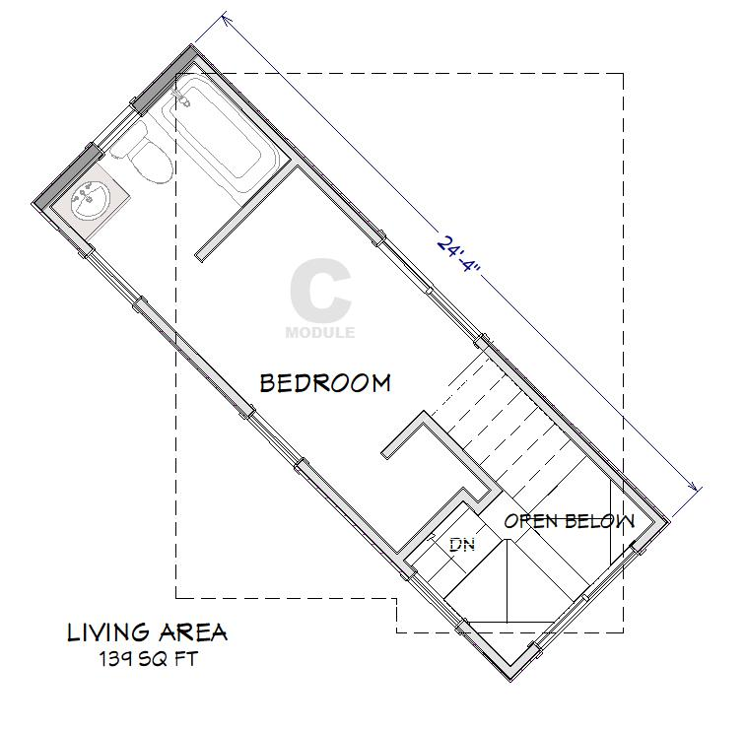
MicroModz 450 1-2 101.5
3 Modules: 18’ 2” & 21’ 3” on Main - 24’ 4” on Upper
2nd Floor
.
Return to Index Page
Copyright 2023 - Singleton Designs, LLC - Newnan, GA

Slide 24
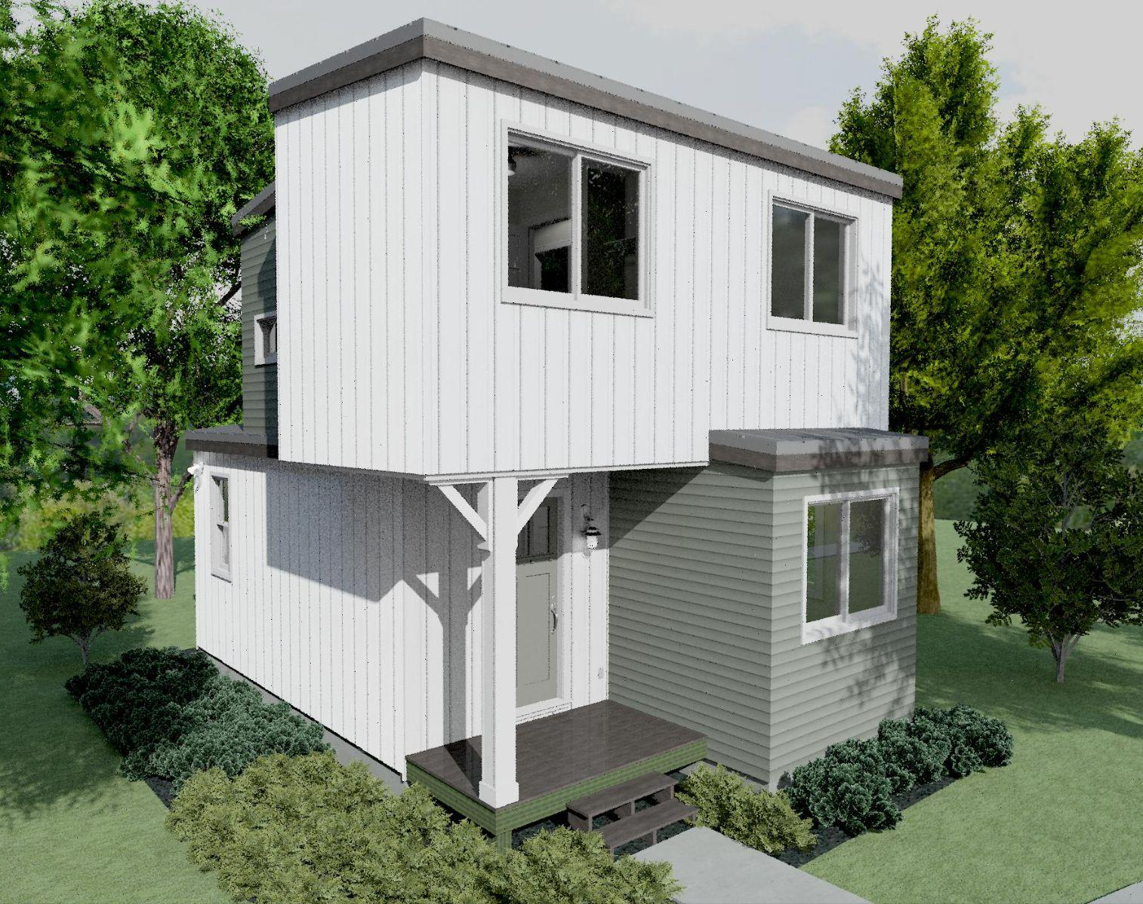
MM 550 2-2 201.5
2 Bedrooms, 1.5 Baths
A micro-sized home with all of the basics.
Follow this link to a Full Construction Plan Set for Review: https://drive.google.com/file/d/1bC2R4v5t74NDbKNIlKS95Nfn7FKFHTOu/view?usp=sharing
Copyright 2023 - Singleton Designs, LLC - Newnan, GA

Slide 25
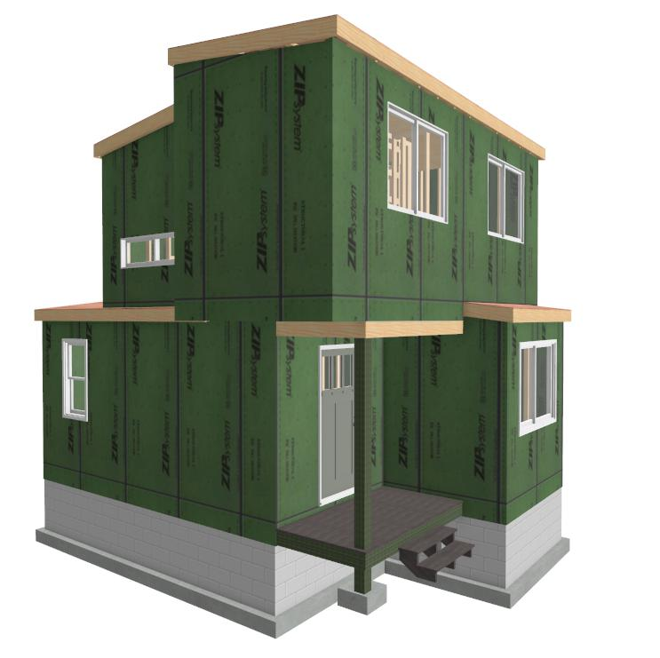
MicroModz 550 2-2 201.5
550 Sq. Ft. 2 BR, 1.5BA, with Entry Foyer
FOLLOW THIS LINK FOR A 3D VIEW OF BOX A FRAMING FOR THIS MODEL
https://3d-viewer.chiefarchitect.com/go?share=118989105740803
Copyright 2023 - Singleton Designs, LLC - Newnan, GA

Slide 26
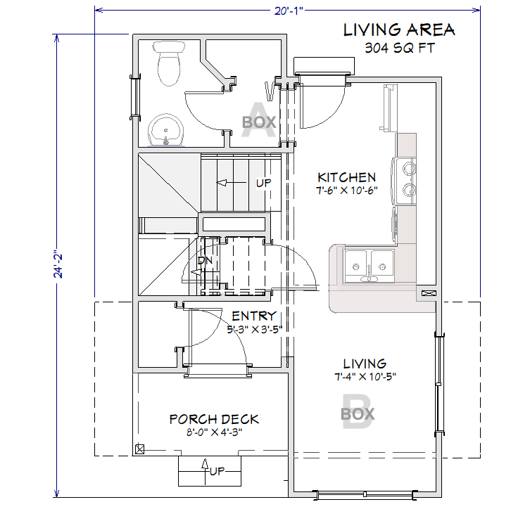
MicroModz 550 2-2 201.5
550 Sq. Ft. 2 BR, 1.5BA with 20’ 1” x 24’ 2” Footprint
1st Floor
.
Copyright 2023 - Singleton Designs, LLC - Newnan, GA

Slide 27
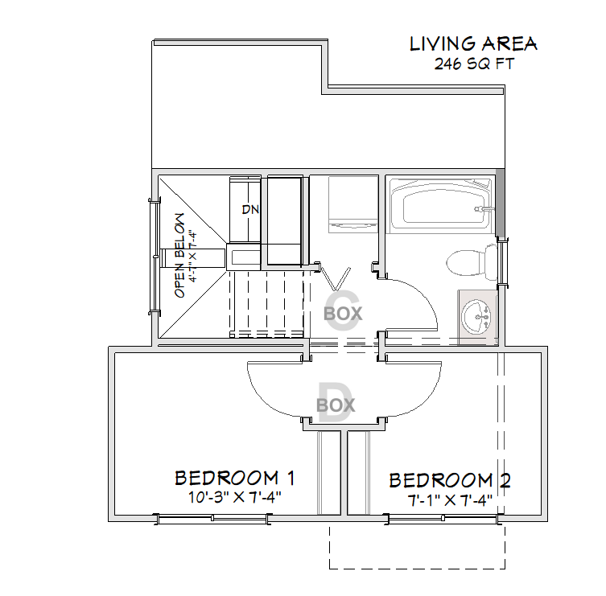
MicroModz 550 2-2 201.5
4 Modules: 18’ & 22’ on Main - 16’ 1” & 20’ on Upper
2nd Floor
.
Return to Index Page
Copyright 2023 - Singleton Designs, LLC - Newnan, GA

Slide 28
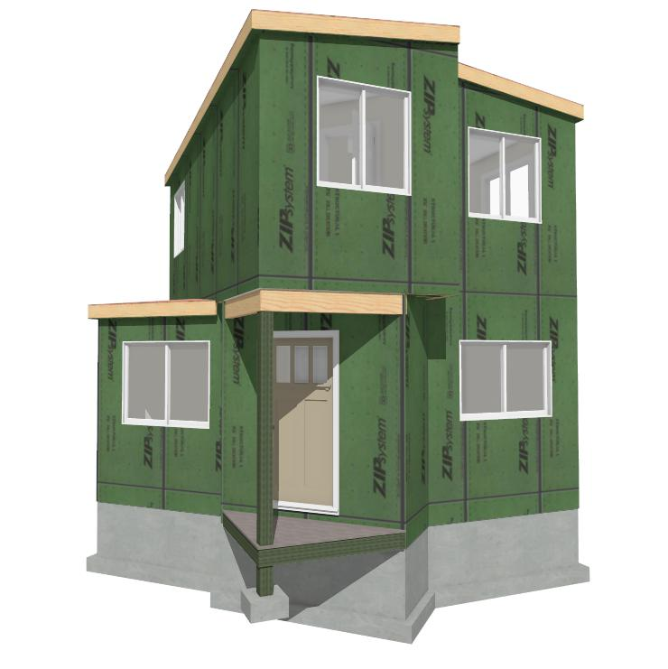
MicroModz 605 2-3 111.5
605 Sq. Ft. 1 BR, 1.5BA, with Loft Area upstairs
Front View
Copyright 2023 - Singleton Designs, LLC - Newnan, GA

Slide 29
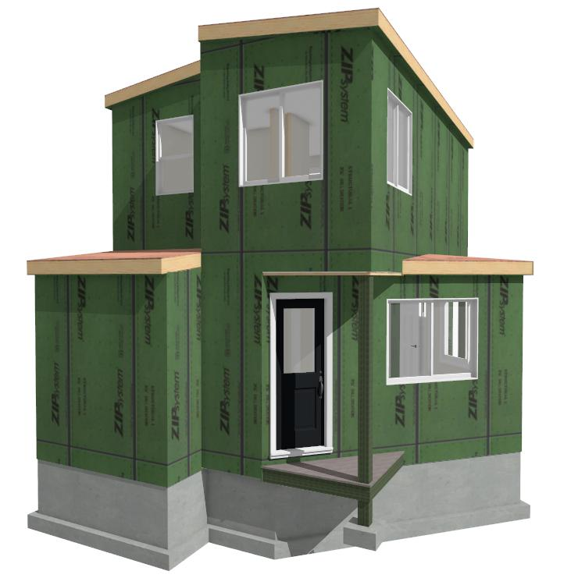
MicroModz 605 2-3 111.5
3 Boxes on 1st: 15’ 10”, 10’ 11”, & 22’ - 2nd: 16’ 10” & 22’
Rear View
Copyright 2023 - Singleton Designs, LLC - Newnan, GA

Slide 30
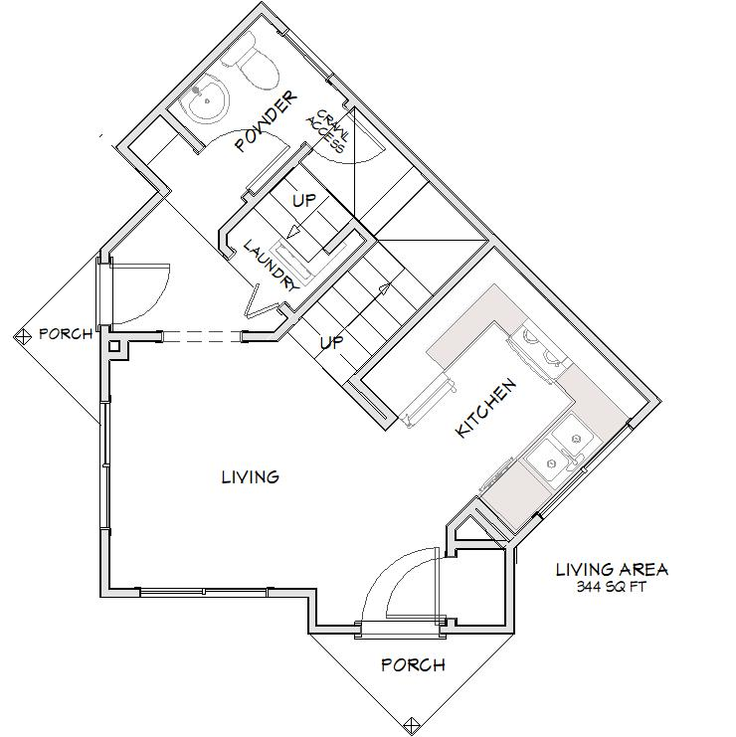
MicroModz 605 2-3 111.5
344’ on 1st w/ 1 BR, 1.5BA with 24’ 4” x 20’ 10” Footprint
1st Floor
.
Copyright 2023 - Singleton Designs, LLC - Newnan, GA

Slide 31
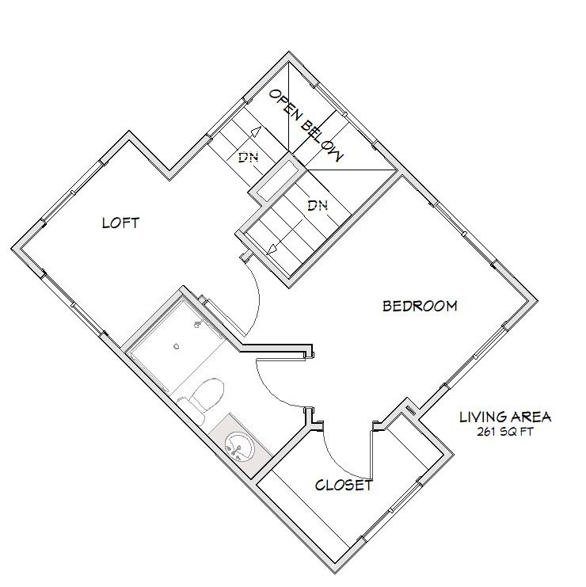
MicroModz 605 2-3 111.5
2nd Floor Master Suite features Loft & Walk-in Closet
1st Floor
.
Return to Index Page
Copyright 2023 - Singleton Designs, LLC - Newnan, GA

Slide 32
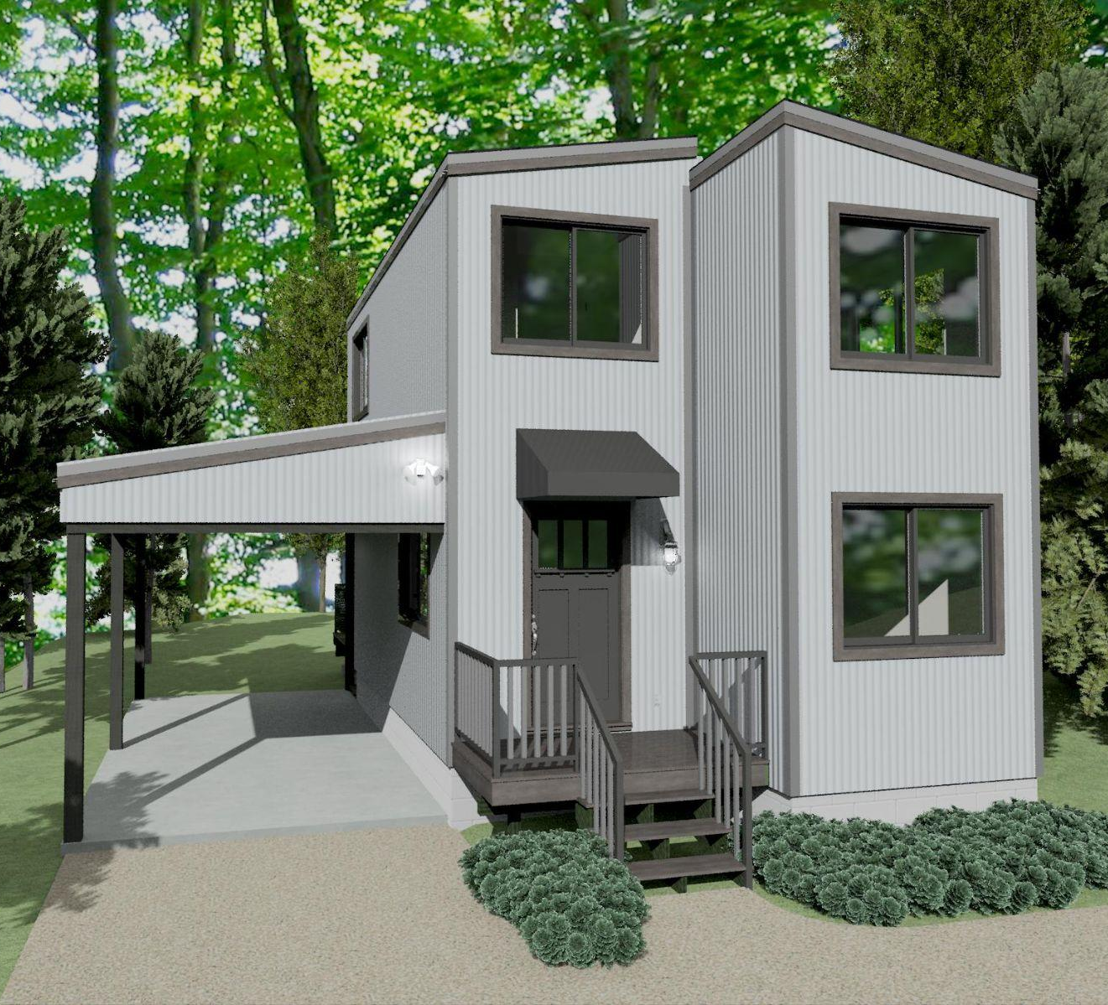
MicroModz 683 2-2 212
683 Sq. Ft. 2 BR, 2BA, Office/Guest & Carport added
This plan is currently under revision. Size & configuration may change slightly
Copyright 2023 - Singleton Designs, LLC - Newnan, GA

Slide 33
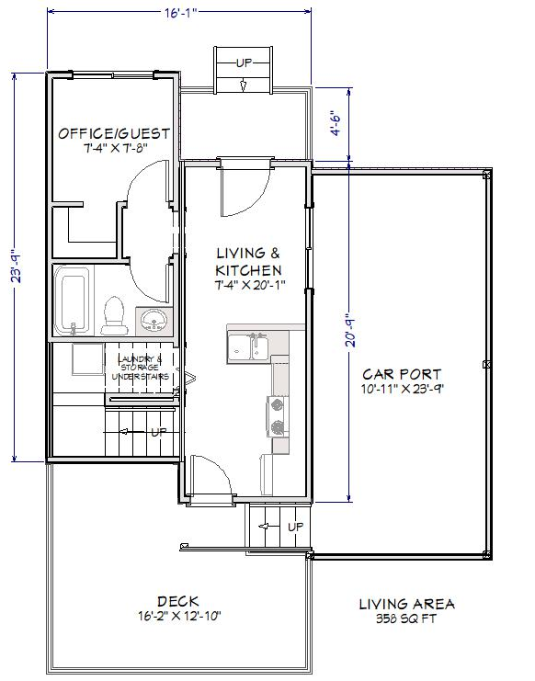
MicroModz 683 2-2 212
683 Sq. Ft. 2 BR, 2 BA, + Office -16’ 1” x 26’ 2” Footprint
1st Floor
.
Copyright 2023 - Singleton Designs, LLC - Newnan, GA

Slide 34
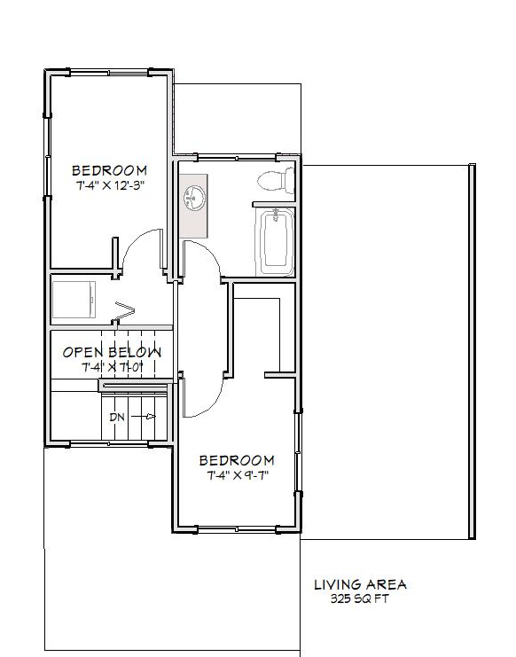
MicroModz 683 2-2 212
Modules: 20’ 9” & 23’ 9” on Main - 2 @ 23’ 9” Upper
2nd Floor
.
Return to Index Page
Copyright 2023 - Singleton Designs, LLC - Newnan, GA

Slide 35
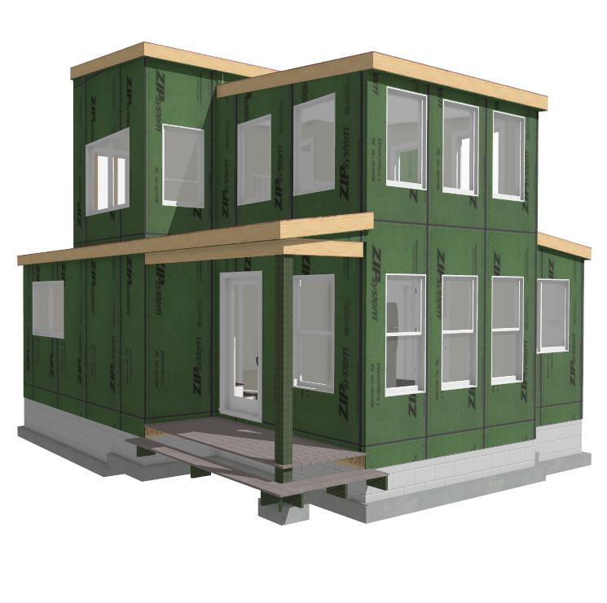
MicroModz 750 3-3 212.5
750 Sq. Ft. 2 BR, 2.5 BA, with Vaulted Great Room
Plans for this model are under development
Front View
Copyright 2023 - Singleton Designs, LLC - Newnan, GA

Slide 36
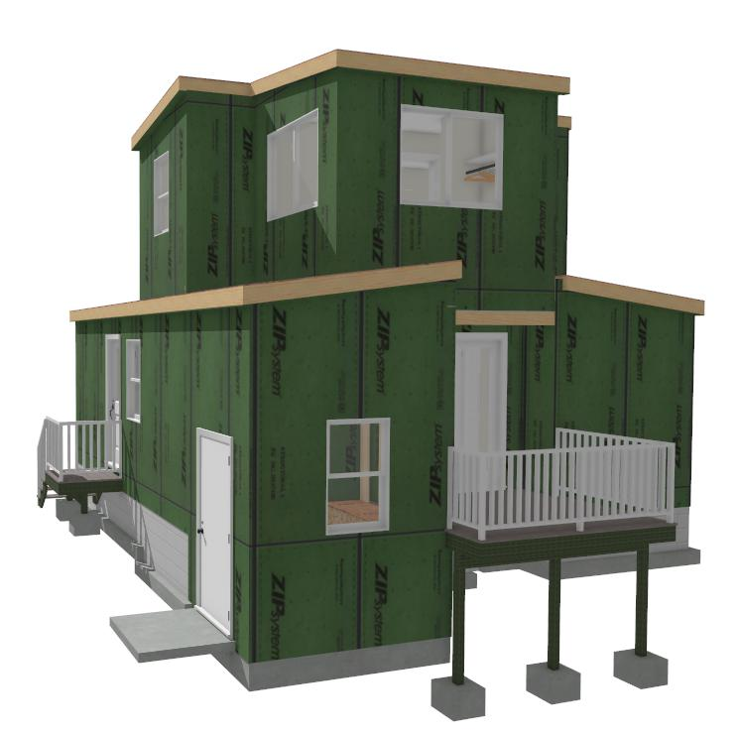
MicroModz 750 3-3 212.5
Outside Storage, Side entrance to Kitchen, and private rear Deck off of Master Bedroom
Rear View
T
Copyright 2023 - Singleton Designs, LLC - Newnan, GA

Slide 37
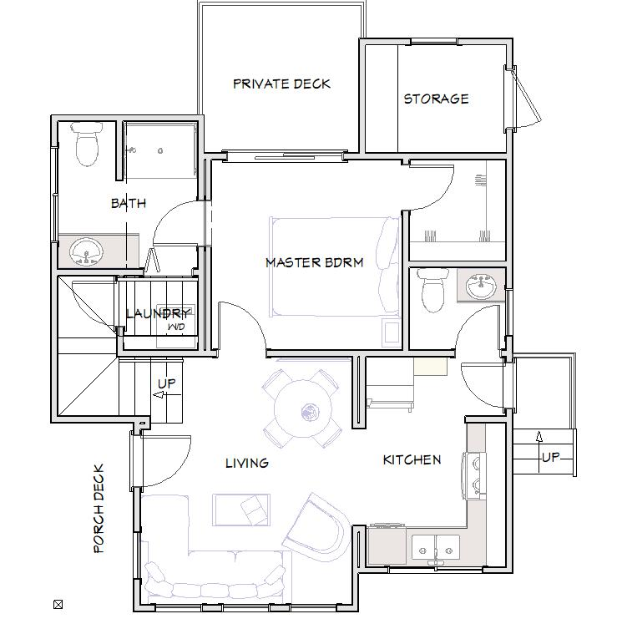
MicroModz 750 3-3 212.5
750 Sq. Ft. 2 BR, 2.5 BA w/ Loft & Vaulted Living
1st Floor
.
Copyright 2023 - Singleton Designs, LLC - Newnan, GA

Slide 38
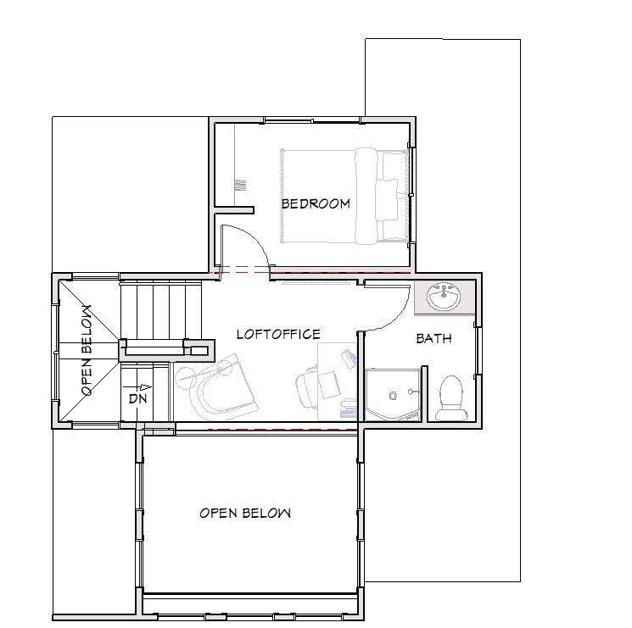
MicroModz 750 3-3 212.5
Modules: on Main: 24’, 26’ & 28’
Modules on Upper: 22’ 2, 10’ 8”” & 11’ 9”
2nd Floor
.
Return to Index Page
Copyright 2023 - Singleton Designs, LLC - Newnan, GA

Slide 39
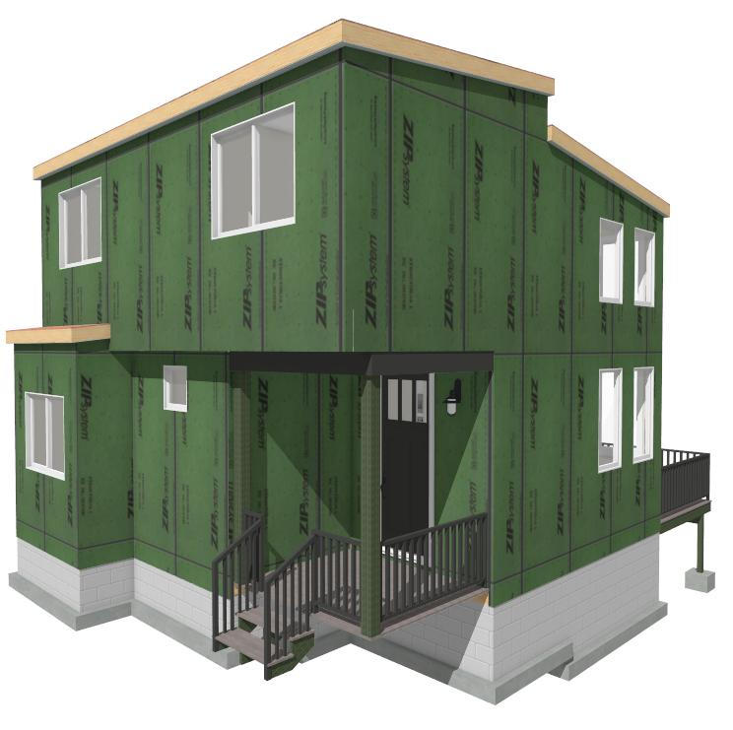
MicroModz 801 3-3 302
801 Sq. Ft. 3 BR, 2 BA, with Vaulted Great Room
Plans for this model are under development
Front View
T
Copyright 2023 - Singleton Designs, LLC - Newnan, GA

Slide 40
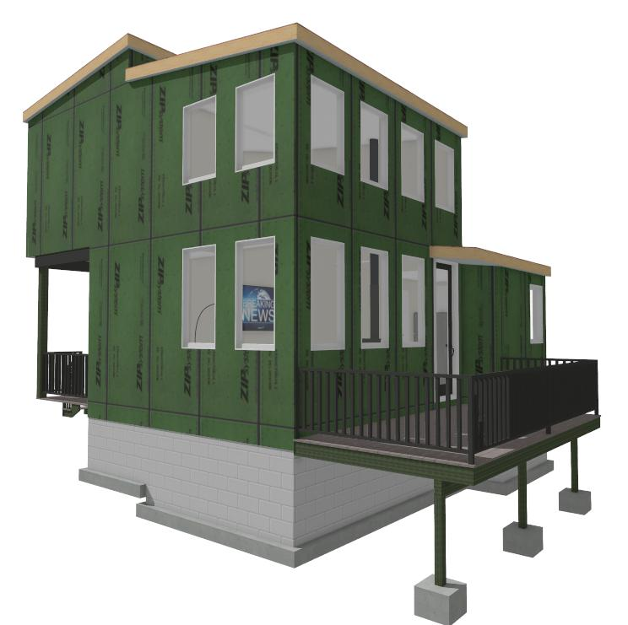
MicroModz 801 3-3 302
801 Sq. Ft. 3 BR, 2 BA, with Vaulted Great Room
Plans for this model are under development
Rear View
Copyright 2023 - Singleton Designs, LLC - Newnan, GA

Slide 41
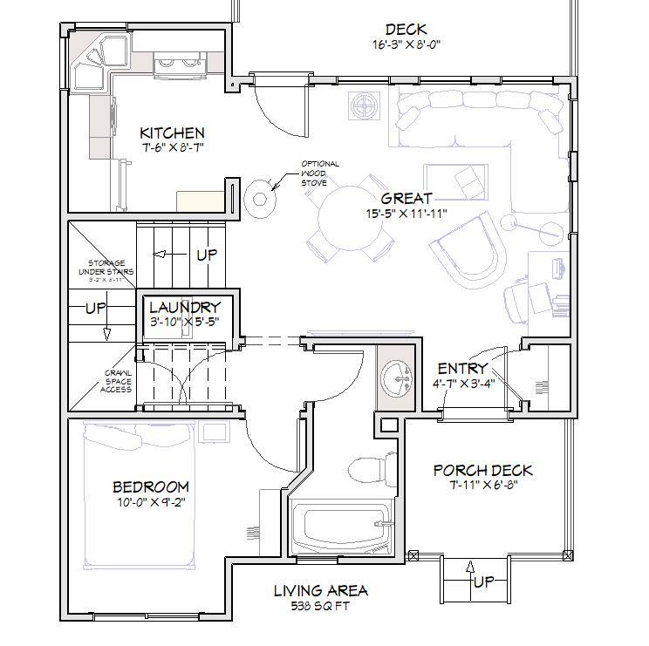
MicroModz 801 3-3 302
801 Sq. Ft. 3BR, 3BA w/ 2 Story GR - 24’ 2” wide x 28”
1st Floor - 9’ Ceilings & 2Story Great Room
.
Copyright 2023 - Singleton Designs, LLC - Newnan, GA

Slide 42
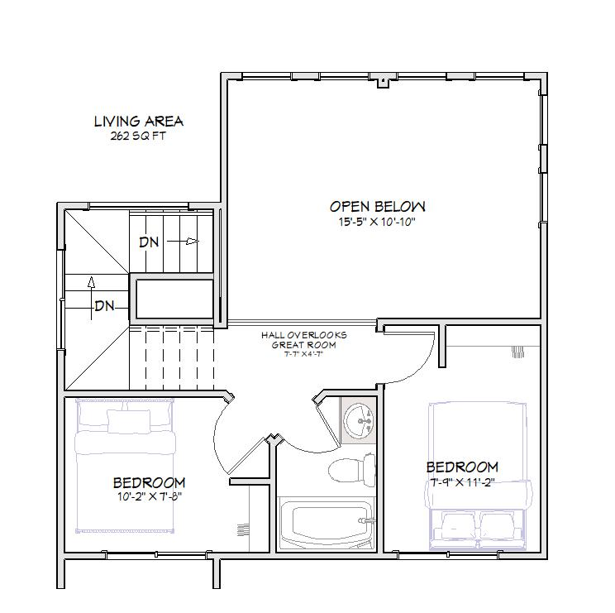
MicroModz 801 3-3 302
Modules: 28’, 23’, & 15” on Main - 2 @ 24’ & 17’7” Upper
2nd Floor
.
Return to Index Page
Copyright 2023 - Singleton Designs, LLC - Newnan, GA

Slide 43
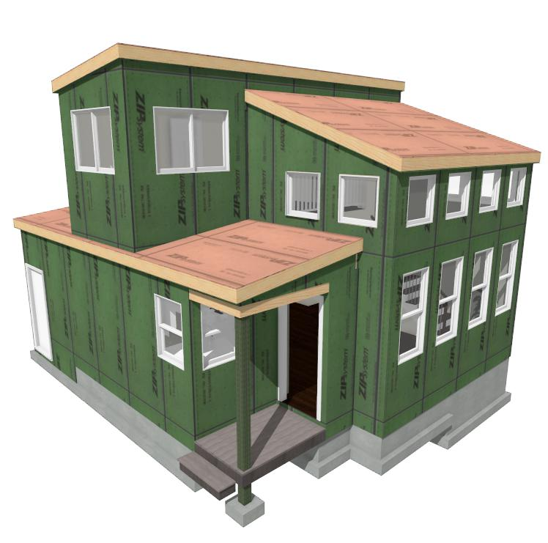
MicroModz 825 3-3 312 + Storage
825 Sq. Ft. 3 BR, 2 BA, with Loft & Vaulted Great Room
Plans for this model are under development
Front View
Copyright 2023 - Singleton Designs, LLC - Newnan, GA

Slide 44
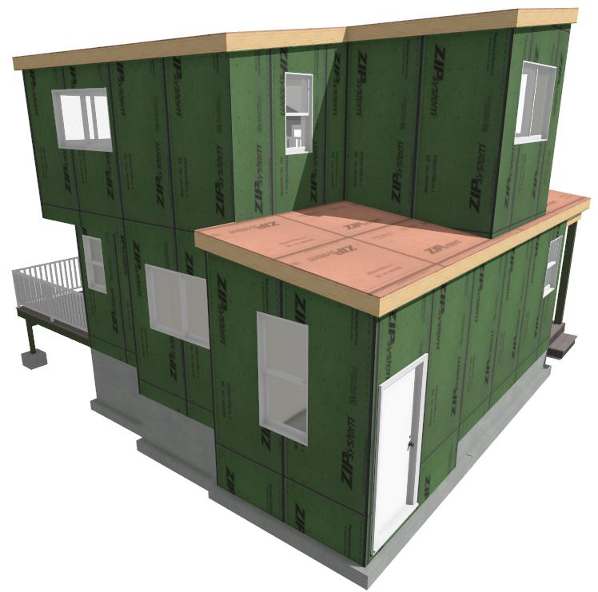
MicroModz 825 3-3 312 + Storage
825 Sq. Ft. 3 BR, 2 BA, with Loft & Vaulted Great Room
Plus side door with Deck access
Rear View
Copyright 2023 - Singleton Designs, LLC - Newnan, GA

Slide 45
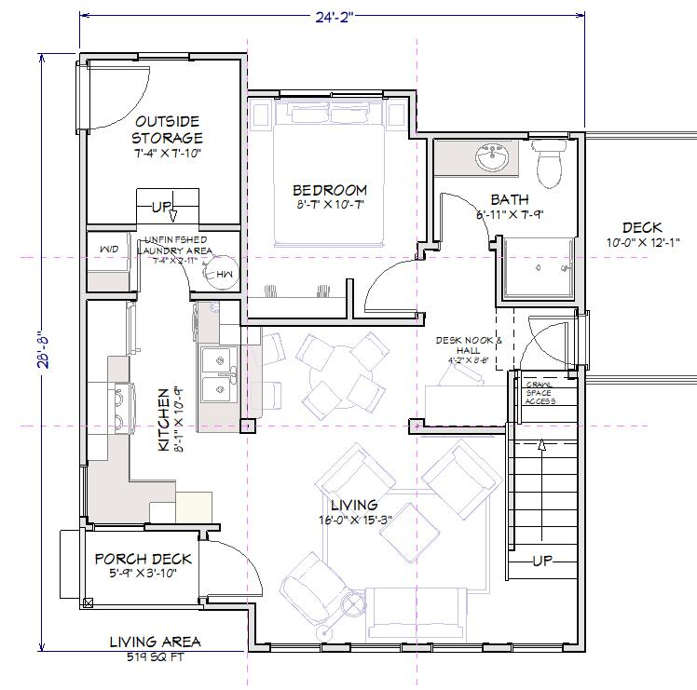
MicroModz 825 3-3 312 + Storage
825 Sq. Ft. 3BR, 3BA w/ 2 Story GR - 24’ 2” wide x
28” 8”
1st Floor - 8’ Ceilings & 2 Story Great Room
.
Copyright 2023 - Singleton Designs, LLC - Newnan, GA

Slide 46
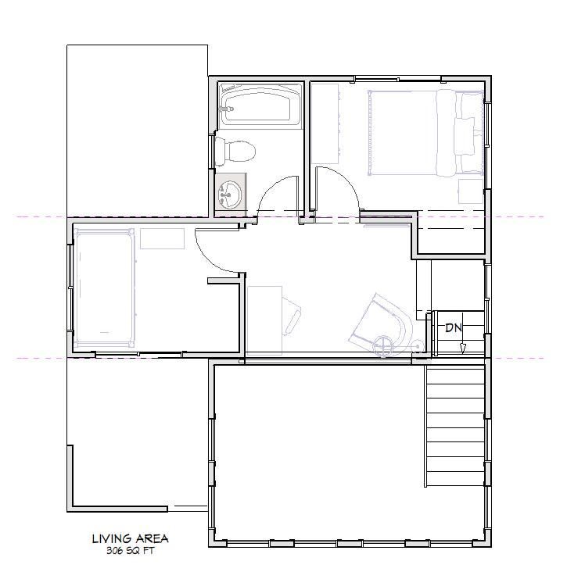
MicroModz 825 3-3 312 + Storage
Modules: 26’ 8”, 27’, & 25” on Main - 16’ 1”, 24’ 2”, & 16’ 1” Special Vaulted Ceiling Module on Upper Level
2nd Floor
.
Return to Index Page
Copyright 2023 - Singleton Designs, LLC - Newnan, GA

Slide 47
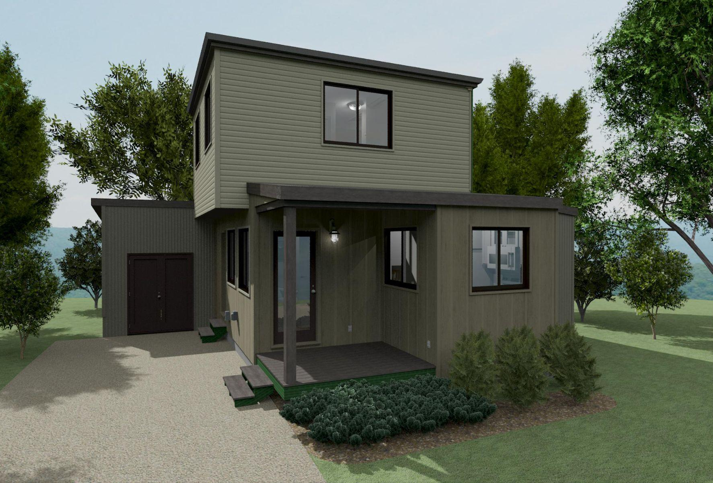
MM 850 2-4 323 + Storage
3 Bedrooms, a Loft, an Office, 3 Bathrooms and Outdoor Storage
This 850 sq. ft. home is suitable for a small family, roommates, a couple, or a single person. 2nd floor space includes a loft for use in a variety of ways. An optional Fireplace or Wood Stove is integrated into this design.
Copyright 2023 - Singleton Designs, LLC - Newnan, GA

Slide 48
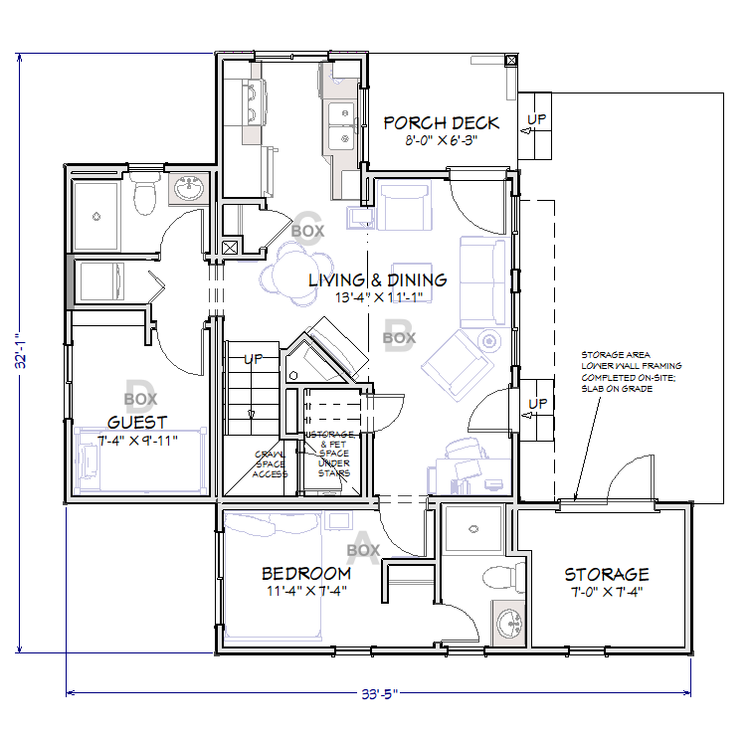
MicroModz 850 2-4 323 + Storage
850 Sq. Ft. 3 BR, 3BA with 33’ 5” x 32’ 1” Footprint
1st Floor
.
Copyright 2023 - Singleton Designs, LLC - Newnan, GA

Slide 49
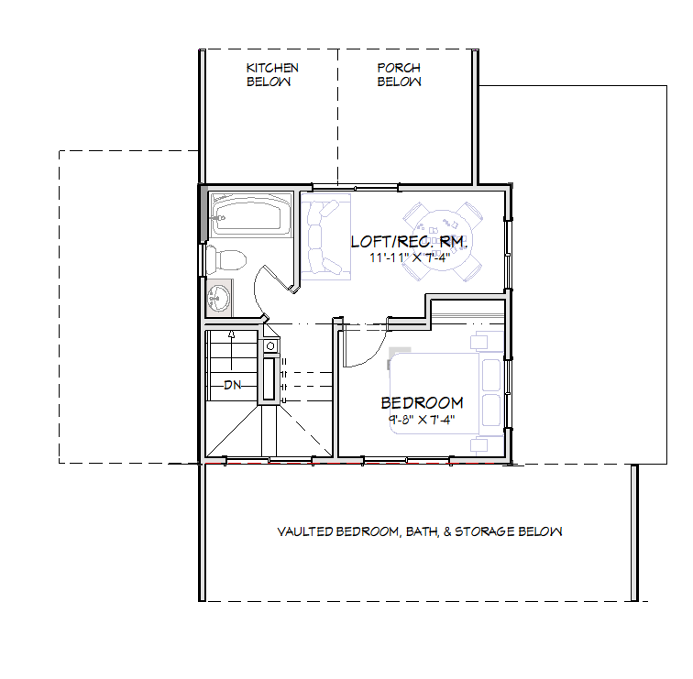
MicroModz 850 2-4 323 + Storage
6 Modules: 25’ 4”’, 24’, 18’ and 17’ 8” on Main - 2 @ 18’ on Upper
2nd Floor
.
Return to Index Page
Copyright 2023 - Singleton Designs, LLC - Newnan, GA

Slide 50
MicroModz 860 3-3 312.5
850 Sq. Ft. 3 BR, 2.5 BA, w/ Loft, Vaulted Living & Outside Storage
Front/Side View
FOLLOW THIS LINK TO VIEW 3D MODEL ON THE CHIEF ARCHITECT SERVER
https://3d-viewer.chiefarchitect.com/go?share=589701451542912
Copyright 2023 - Singleton Designs, LLC - Newnan, GA

Slide 51
MicroModz 860 3-3 312.5
A design featuring lots of light in every room and a private Deck off of Master Bedroom
Rear/Side View
Copyright 2023 - Singleton Designs, LLC - Newnan, GA

Slide 52
MicroModz 860 3-3 312.5
860 Sq. Ft. 3BR, 3BA w/ 2 Story GR - 24’ 2” wide x 28”
1st Floor - 2 Story Great Room & Outside Storage
.
Copyright 2023 - Singleton Designs, LLC - Newnan, GA

Slide 53
MicroModz 860 3-3 312.5
Modules: on Main: 24’, 26’ & 28’
Modules on Upper: 24’ 2, 10’ 8”” & 21’ 2”
2nd Floor
.
Return to Index Page
Copyright 2023 - Singleton Designs, LLC - Newnan, GA

Slide 54
MicroModz 884 3-3 412.5
884 Sq. Ft. 4 BR, 2.5 BA,
Plans for this model are under development
Right Front View
Copyright 2023 - Singleton Designs, LLC - Newnan, GA

Slide 55
MicroModz 884 3-3 412.5
884 Sq. Ft. 4 BR, 2.5 BA,
Plans for this model are under development
Rear View
Copyright 2023 - Singleton Designs, LLC - Newnan, GA

Slide 56
MicroModz 884 3-3 412.5
Master with private Bath on Main. Living Room with fireplace
Main Level
Copyright 2023 - Singleton Designs, LLC - Newnan, GA

Slide 57
MicroModz 884 3-3 412.5
The 3 Bedroom Upper level includes a Loft Area and Walk-in Attic Storage Space
Upper Level
Return to Index Page
Copyright 2023 - Singleton Designs, LLC - Newnan, GA

Slide 58
MicroModz 896 3-3 312
896 Sq. Ft. 3 BR, Loft, 2 BA,
Plans for this model are under development
T
Copyright 2023 - Singleton Designs, LLC - Newnan, GA

Slide 59
MicroModz 896 3-3 312
896 Sq. Ft. 3 BR, Loft, 2 BA,
Plans for this model are under development
T
Copyright 2023 - Singleton Designs, LLC - Newnan, GA

Slide 60
MicroModz 896 3-3 312
This model features a spacious vaulted Living Area
T
Copyright 2023 - Singleton Designs, LLC - Newnan, GA

Slide 61
MicroModz 896 3-3 312
A 2nd Floor Loft has lots of space. For a variety of uses.
T
Return to Index Page
Copyright 2023 - Singleton Designs, LLC - Newnan, GA

Slide 62
MicroModz 901 4-4 302.5 + Storage
901 Sq. Ft. 3 BR, 2.5 BA, + Storage & a vaulted Living Area with windows to capture any view.
Right Front View
Copyright 2023 - Singleton Designs, LLC - Newnan, GA

Slide 63
MicroModz 901 4-4 302.5 + Storage
Access to Outdoor Storage & Living Area on left side.
Left Rear View
Copyright 2023 - Singleton Designs, LLC - Newnan, GA

Slide 64
MicroModz 901 4-4 302.5 + Storage
Master with private Bath on Main. Living Room with wood burning stove
First Floor
Copyright 2023 - Singleton Designs, LLC - Newnan, GA

Slide 65
MicroModz 901 4-4 302.5 + Storage
Modules on Main: 16’, 16’, 18’ 6”, & 28’ Upper Level modules: 16’, 19’6, 9’,& 30’
Second Floor
Return to Index Page
Copyright 2023 - Singleton Designs, LLC - Newnan, GA

Slide 66
MicroModz 927 3-3 413.5
927 Sq. Ft. 4 BR, 3.5 BA, w/ small Loft Area
Plans for this model are under development
Right Front View
Copyright 2023 - Singleton Designs, LLC - Newnan, GA

Slide 67
MicroModz 927 3-3 413.5
An “In-Suite” Bath added to an upstairs Bedroom add a3 Sq. Ft, of functionality to the MM 884 plan
Rear View
Copyright 2023 - Singleton Designs, LLC - Newnan, GA

Slide 68
MicroModz 927 3-3 413.5
Master with private Bath on Main. Living Room with fireplace
Main Level
Copyright 2023 - Singleton Designs, LLC - Newnan, GA

Slide 69
MicroModz 927 3-3 413.5
A Bath added to the 3 Bedroom Upper level enhances the functionality of this living space
Upper Level
Return to Index Page
Copyright 2023 - Singleton Designs, LLC - Newnan, GA

Slide 70
MicroModz 950 2-3-2 303.5, 3 Floors
950 Sq. Ft. 3 BR, 3.5 BA, w/Master on 3rd Floor
Copyright 2023 - Singleton Designs, LLC - Newnan, GA

Slide 71
MicroModz 950 2-3-2 303.5, 3 Floors
950 Sq. Ft. 3 BR, 3.5 BA -16’ 1” x 24’ 2” Footprint
.
Copyright 2023 - Singleton Designs, LLC - Newnan, GA

Slide 72
MicroModz 950 2-3-2 303.5, 3 Floors
Modules: 20’ 2” & 24’ 2” on Main - 18’, 16’ 1” & 19’ 1” on 2nd
.
Copyright 2023 - Singleton Designs, LLC - Newnan, GA

Slide 73
MicroModz 950 2-3-2 303.5, 3 Floors
Modules: 17’ 7” & 16’ 1” on 3rd Level
3rd Floor
.
Return to Index Page
Copyright 2023 - Singleton Designs, LLC - Newnan, GA

Slide 74
MicroModz 1000 3-3 303.5
1000+ Sq. Ft. 3 BR, 3.5 BA,
Plans for this model are under development
T
Copyright 2023 - Singleton Designs, LLC - Newnan, GA

Slide 75
MicroModz 1000 3-3 303.5
A great In-Law Suite on the 1st Floor (ADA compliance is possible)!
T
Copyright 2023 - Singleton Designs, LLC - Newnan, GA

Slide 76
MicroModz 1000 3-3 303.5
The Master and Secondary Bedrooms on 2nd Floor both offer very comfortable sized spaces.
T
Return to Index Page
Copyright 2023 - Singleton Designs, LLC - Newnan, GA

Slide 77
MicroModz 1012 3-3 423.5
1012 Sq. Ft. 4 BR, 3.5 BA, Loft & Office/Sitting Area
Plans for this model are under development
Copyright 2023 - Singleton Designs, LLC - Newnan, GA

Slide 78
MicroModz 1012 3-3 423.5
A great In-Law Suite on the 1st Floor (ADA compliance is possible)!
T
Copyright 2023 - Singleton Designs, LLC - Newnan, GA

Slide 79
MicroModz 1012 3-3 423.5
A Master Suite on the 2nd Floor has a Bath and Office/Sitting Area
T
Return to Index Page
Copyright 2023 - Singleton Designs, LLC - Newnan, GA

Slide 80
MicroModz 1040 3-3 503.5
1040 Sq. Ft. 5 BR, 3.5 BA,
Plans for this model are under development
Right Front View
Copyright 2023 - Singleton Designs, LLC - Newnan, GA

Slide 81
MicroModz 1040 3-3 503.5
Sitting/Office Area from the MM 10112 model is expanded and converted to a 5th Bedroom in this big family model
Upper Level
Copyright 2023 - Singleton Designs, LLC - Newnan, GA

Slide 82
MicroModz 1040 3-3 503.5
Master with private Bath on Main. Living Room with fireplace
Main Level
Copyright 2023 - Singleton Designs, LLC - Newnan, GA

Slide 83
MicroModz 1040 3-3 503.5
A Bath added to the 3 Bedroom Upper level enhances the functionality of this living space
Upper Level
Return to Index Page
Copyright 2023 - Singleton Designs, LLC - Newnan, GA

